Slide 1
Operating System Design
Chapter 15
15.1 The nature of the design problem
15.2 Interface design
15.3 Implementation
15.4 Performance
15.5 Project management
15.6 Trends in operating system design

Slide 2
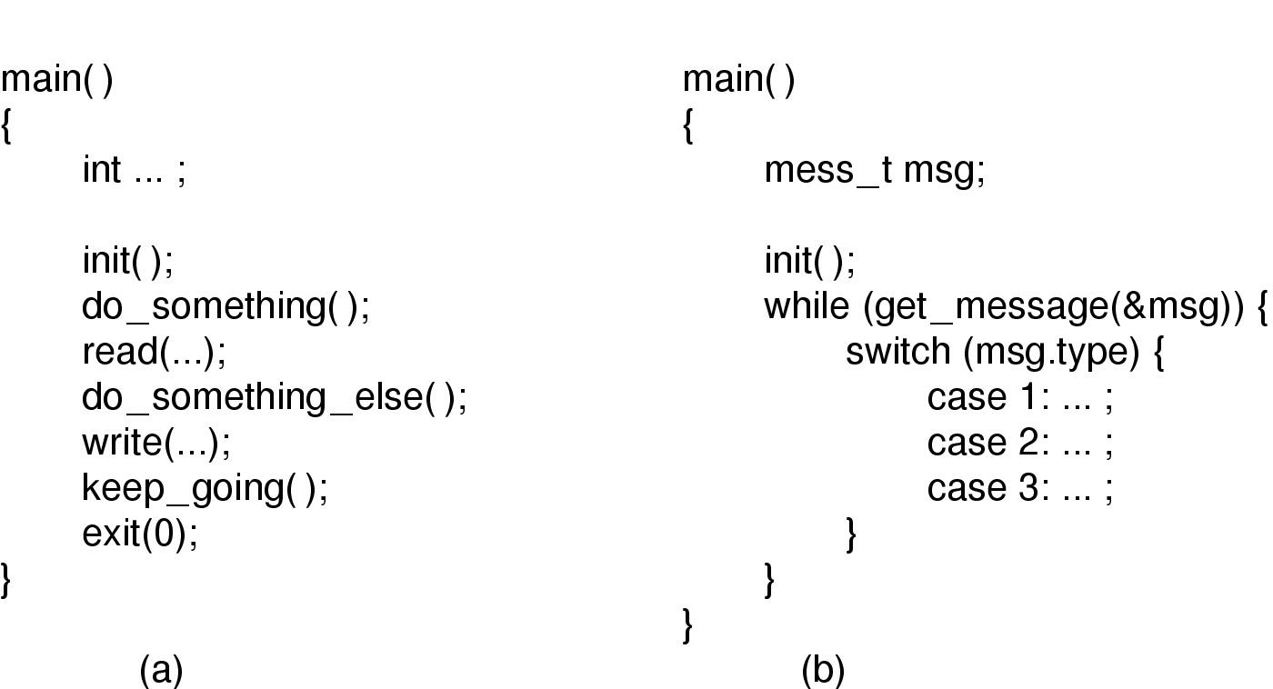
Paradigms (1)
Algorithmic code

Slide 3
Paradigms (2)
Event-driven code

Slide 4
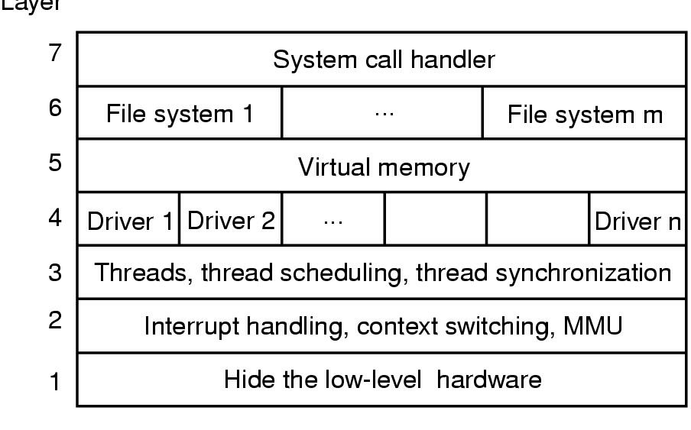
Implementation
Layer
One possible design for a modern layered operating system

Slide 5
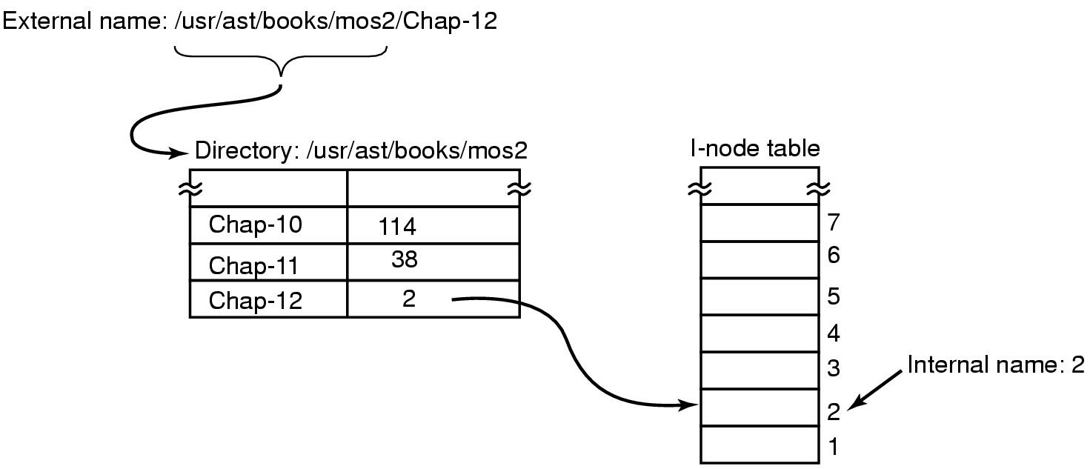
Naming
Directories are used to map external names onto internal names

Slide 6
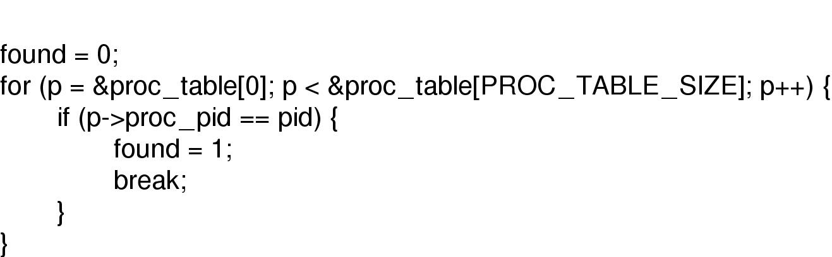
Static Versus Dynamic Structures
Code for searching the process table for a given PID.
Searching a static table for a pid

Slide 7
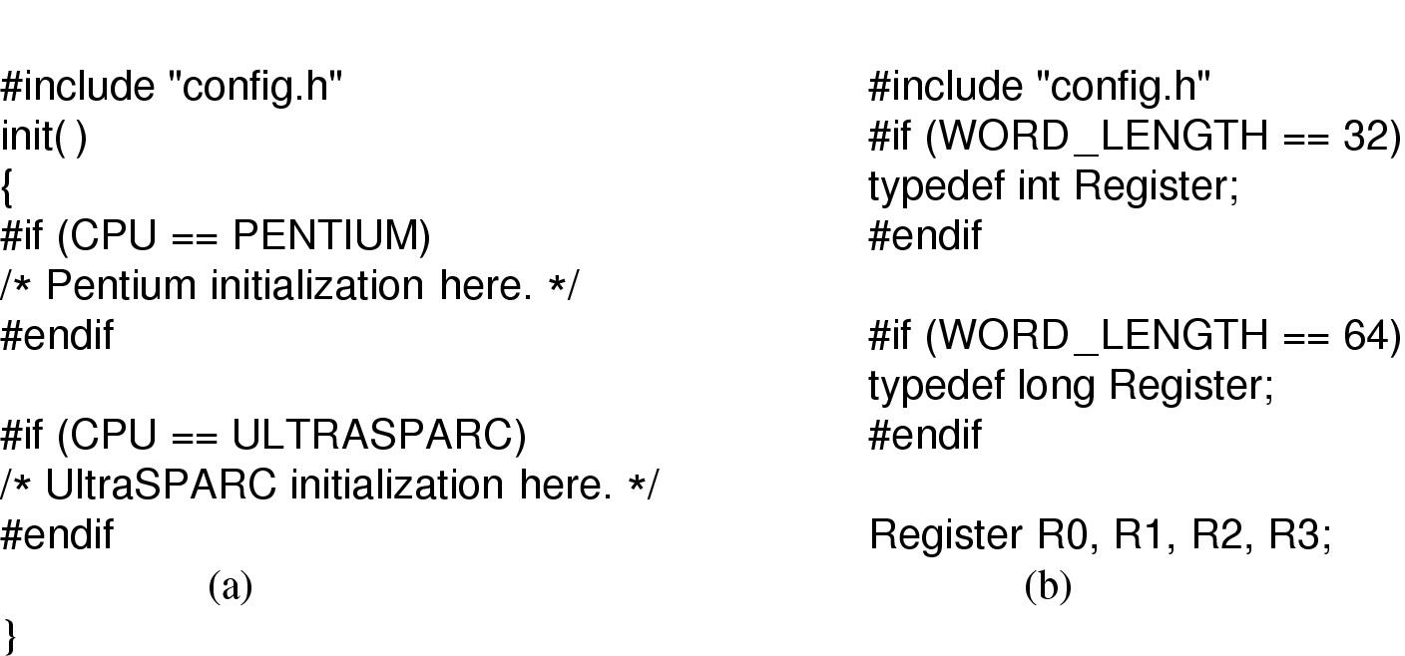
Hiding the Hardware (1)
CPU-dependent conditional compilation

Slide 8
Hiding the Hardware (2)
Word-length dependent conditional compilation

Slide 9
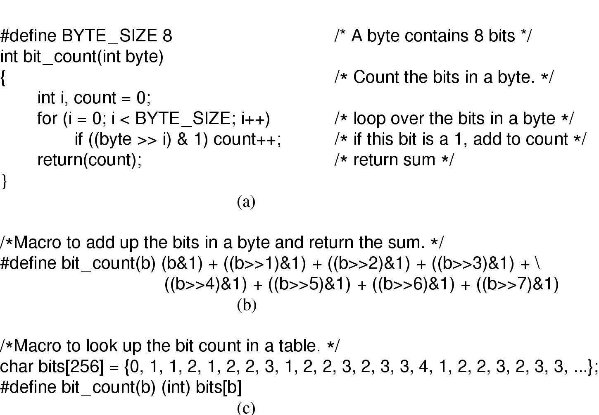
Space-Time Trade-offs (1)
A procedure for counting bits in a byte
(a)
A procedure to count the 1 bits in a byte

Slide 10
Space-Time Trade-offs (2)
A macro to count the bits
A macro to access bit count in a table
(b) Macro to count the bytes
(c) Macro to look up the count

Slide 11
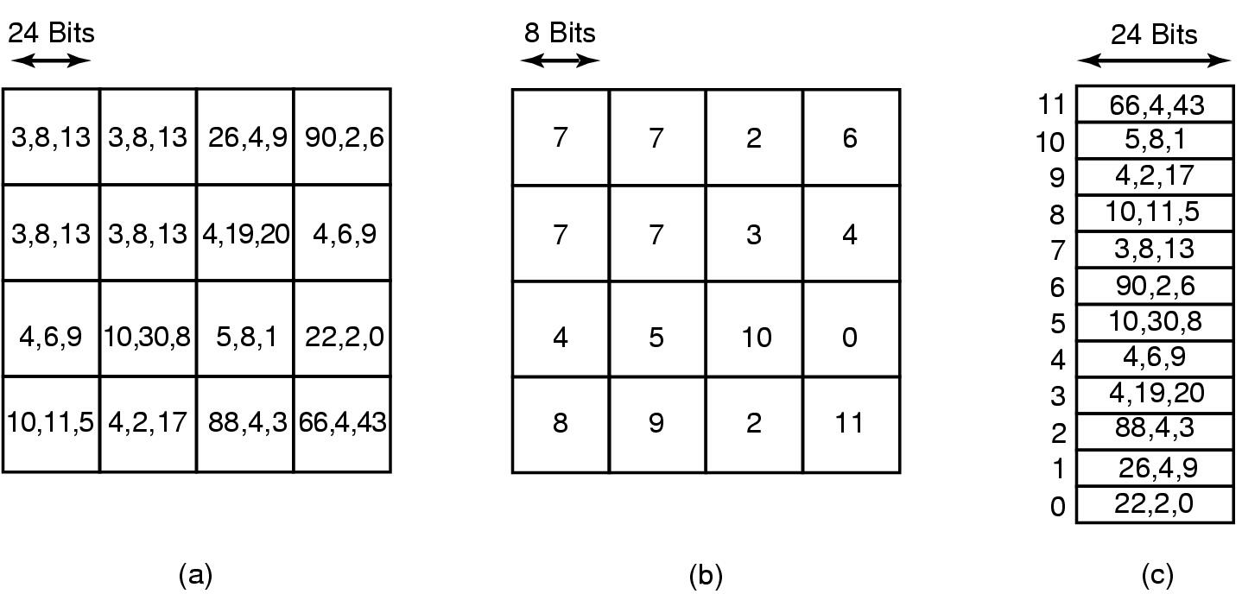
Space-Time Trade-offs (3)
(a) Part of an uncompressed image with 24 bits per pixel
(b) Same part compressed with GIF, 8 bits per pixel
(c) The color palate

Slide 12
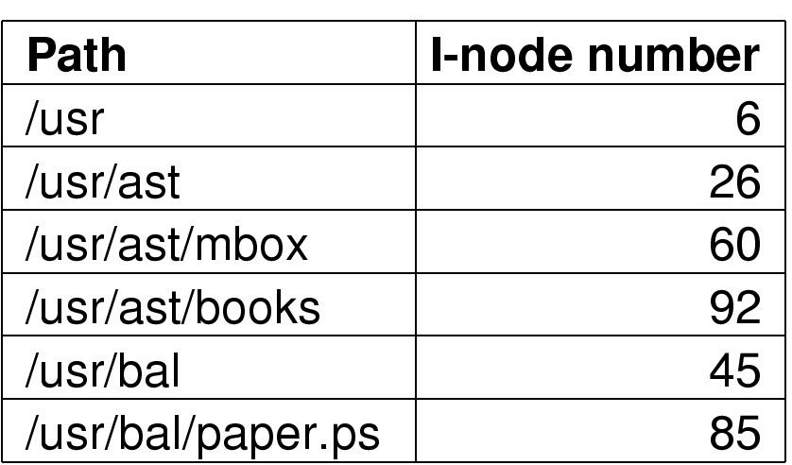
Caching
Part of an i-node cache

Slide 13
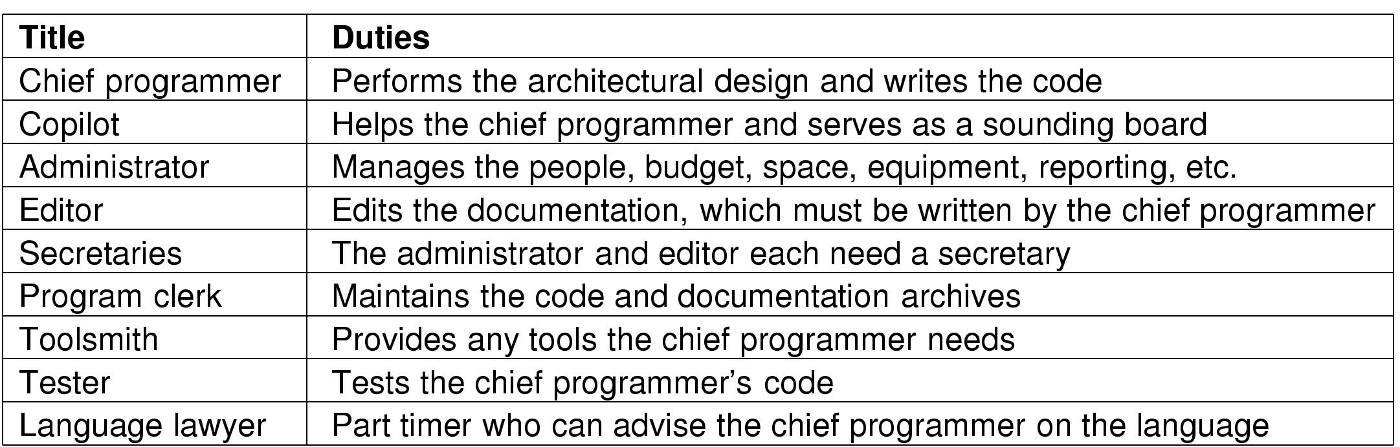
Software team Structure
Mills’ proposal for populating a 10-person chief programmer team

Slide 14
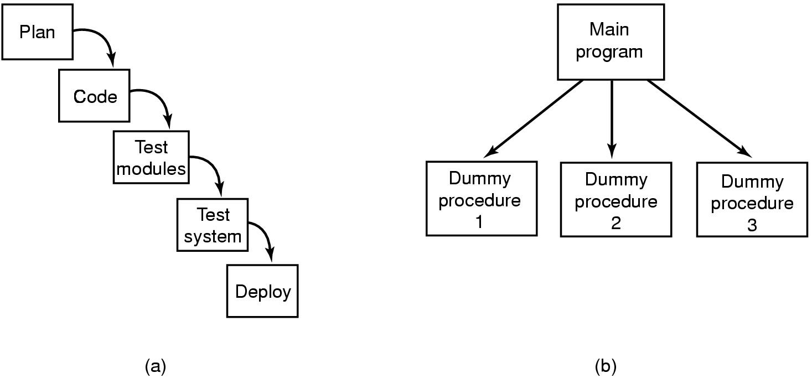
The Role of Experience (1)
Traditional software design progresses in stages

Slide 15
The Role of Experience (2)
Alternative design produces a working system
  that does nothing starting on day 1

